Slide 1


Slide 2
EcoStruxure
  EcoStruxure by Schneider Electric is one of the big names in building Management systems. Your building can be accessed from anywhere in the world using your favorite browser, eliminating the need for special software on the workstation or tablet.
  EcoStruxure has a REST-like API in its Smart Connector framework. It consists of a username and password.

Slide 3
Why Use this Connector?
Connectors get the same names as you might see in the BAS’ API whereas going BACnet can yield different names and increase the amount of time taken for the import process
Some systems like Andover cannot be accessed via BACnet
Several debugging tools are built into this connector
Several extra features such as access to alarm events and notifications are built into this connector
There is a fully functional builder tree for navigation which can also navigate you to non-points

Slide 4
Licensing
  Each EcoStruxure connector extension is licensed to a single SkySpark Node Id
  Each EcoStruxure connector extension is licensed to a set maximum number of points
  If either of these states goes into fault, the issue must be corrected and SkySpark must be restarted

Slide 5
Setting Up the EcoStruxure Smart Connector Service
  This SkySpark extension essentially needs to talk to an Extension on the EcoStruxure side
  There are three data providers are available insider of Smart Connector
      MongooseEwsRestProvider
      SboEwsRestProvider
      SoapEwsRestProvider
  It has been determined that SoapEwsRestProvider is the most secure, so this EcoStruxure connector is designed to work with that. That is the data provider that will need to be set up. There is a one-time cost from Schneider Electric to license this software.

Slide 6
EcoStruxure Connectors in SkySpark
In the connector app, select new and pick ecoStruxure, then fill in the following fields:
dis: Display name
uri: `https://host/`
ecoStruxureUsername: Provided by EcoStruxure admin
ecoStruxurePassword: Provided by EcoStruxure admin
actorTimeout: How long a busy connector will wait to respond to a new message
ecoStruxurePollFreq: Minimum amount of time between cache refreshes. This determines how often the curVal values will be updated. The default value of 1min is a good starting point.
All EcoStruxure connector records will have the ecoStruxureConn and conn tags
ecoStruxureLearnContainers: The ecoStruxureLearnContainers() function will take all ecoStruxureContainers from all points in watch. More containers to be used with this function can be added here.
ecoStruxurePointContainers: In the builder tree, these are the containers that are assumed to have point records below them

Slide 7
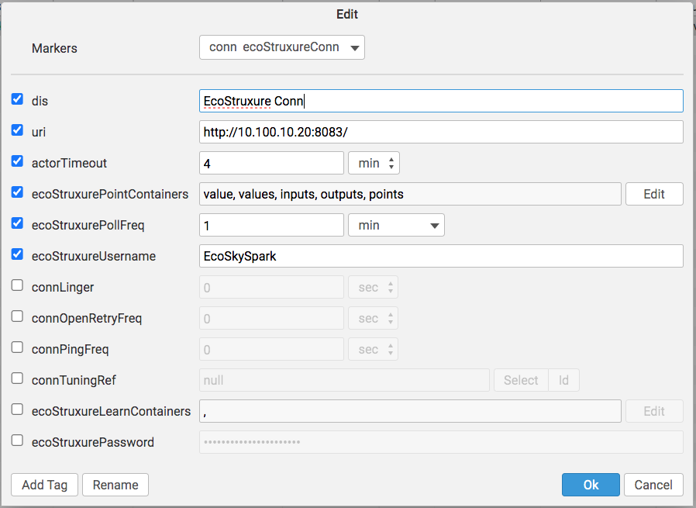
EcoStruxure Connector

Slide 8
EcoStruxure Connector Set Up
  You must set up the API on the EcoStruxure side, then SkySpark will be able to talk to it. As long as the uri, username, and password are correct, it should work.
  If for some reason the system does not auto-authenticate, this function can be used to test the connection and fix the authentication:
    read(ecoStruxureConn).ecoStruxureToken

Slide 9
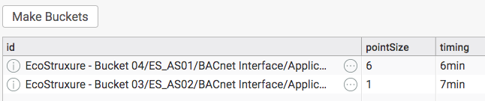
Setting Up Tuning Buckets
Tuning buckets allow you to easily set up curVal points to sync in batches. The timing field in this view is actually the pollFreq and is how often new values are checked for for a given point.
Go to the EcoStruxure App
Go to the Tuning Buckets Tab
Click Make Buckets. This is strongly recommended due to the fact that points in the same containers should be synching at the same time to reduce the number of calls and the load on the systems. In this case, you will also want to push this button after adding points to the connector so the new points use the buckets framework.
doStart is the number of minutes the buckets will start at
doEnd is the number of minutes the buckets will go to until they loops back around to the doStart value

Slide 10

Polling of curVal
ecoStruxurePollFreq (duration)
  How often you want SkySpark to poll the connector for COV
  The default is 1min
  It is a tuning parameter
  Note that this determines how often the curVal in SkySpark changes. You would still need to set how often the data is collected with the hisCollect tags.

Slide 11
EcoStruxure Functions Part I
ecoStruxureSyncHis – sync history from a trend log.
  readAll(ecoStruxureHis).ecoStruxureSyncHis(null)
ecoStruxureSyncCur – force one or more points to sync
  readAll(ecoStruxureCur).ecoStruxureSyncCur
ecoStruxurePing – send ping to connector to check connection
  read(ecoStruxureConn).ecoStruxurePing
ecoStruxureToken – Getting an authentication token is handled automatically in the background, but this can test a connection and can be used if a function does not auto-authenticate for some reason
  read(ecoStruxureConn).ecoStruxureToken
ecoStruxureLearnContainers – Used as a standard point learn based on the points being watched and the containers on the connector’s ecoStruxureLearnContainers tag
  read(ecoStruxureConn).ecoStruxureLearnContainers()
ecoStruxureLearnPoints – used for the builder learn, but get the children nodes for any node as if they were points
  read(ecoStruxureConn).ecoStruxureLearnPoints("School/AS01/Application")

Slide 12
EcoStruxure Functions Part 2
ecoStruxureRoot – used for the builder learn, but get the root node
  read(ecoStruxureConn).ecoStruxureRoot()
ecoStruxureChildren – used for the builder learn, but get the children nodes for any node
  read(ecoStruxureConn).ecoStruxureChildren("parent")
ecoStruxureHisRead – attempt to do a raw read from EcoStruxure without synching (will tell you if point is trended)
  read(ecoStruxureConn).ecoStruxureHisRead(read(ecoStruxureHis))
  read(ecoStruxureConn). ecoStruxureHisRead("pointAddr", today)
ecoStruxureVals – return a list of addresses and curVals (good for testing if an address exists)
  Put the debug tag on the connector to get all the tags on the points as they are seen from EcoStruxure
  read(ecoStruxureConn).ecoStruxureVals(readAll(ecoStruxureCur).toRecList)
  read(ecoStruxureConn).ecoStruxureVals(["pointAddr1", "pointAddr2"])

Slide 13
EcoStruxure Functions Part 3
ecoStruxureAlarmTypes – view alarm types
  read(ecoStruxureConn).ecoStruxureAlarmTypes()
ecoStruxureAlarmEvents – view alarm events from EcoStruxure!
  read(ecoStruxureConn).ecoStruxureAlarmEvents()
ecoStruxureNotifications – view notifications from EcoStruxure!
  read(ecoStruxureConn).ecoStruxureNotifications()
ecoStruxureSubs – view subscriptions
  read(ecoStruxureConn).ecoStruxureSubs()
ecoStruxureSystemEvents – view system events
  read(ecoStruxureConn).ecoStruxureSystemEvents()
ecoStruxureSystemEventTypes – view system event types
  read(ecoStruxureConn).ecoStruxureSystemEventTypes()

Slide 14
EcoStruxure POST Functions
ecoStruxureAlarmEventAck – acknowledge an EcoStruxure alarm event
  read(ecoStruxureConn).ecoStruxureAlarmEventAck()
ecoStruxureCreateSub – create a subscription
  read(ecoStruxureConn).ecoStruxureCreateSub(body)

Slide 15
EcoStruxure View Functions
ecoStruxureDupFinder – find points with the same addresses (default true will add dupPoint tag to point)
  ecoStruxureDupFinder(true)
ecoStruxureMakePointsToBuckets – assigns tuning records to EcoStruxure curVal points (use ecoStruxureTuningBuckets view)
  Number of points per connTuningRec
  ecoStruxureMakePointsToBuckets()
ecoStruxureMakeTuningBuckets – makes EcoStruxure Tuning records (use ecoStruxureTuningBuckets view)
  Number of points per connTuningRec, starting pollFreq, max pollFreq
  ecoStruxureMakeTuningBuckets(6min, 14min)
ecoStruxureViewStatus – see EcoStruxure points
  ecoStruxureViewStatus()
ecoStruxureViewSummary – see status of EcoStruxure points
  ecoStruxureViewSummary()
ecoStruxureViewTuning – display EcoStruxure tuning records
  ecoStruxureViewTuning()

Slide 16
Getting Data for EcoStruxure Points
Manually or Automatically
  Collecting current values (from curVal):
    Each point must have these tags:
      ecoStruxureConnRef (ref) which is a ref that points to the EcoStruxure Connector
      ecoStruxureCur (str) which points to the EcoStruxure point object
      his (marker)
      cur (marker)
      hisCollectCov (marker or number) for cov collection OR
      hisCollectInterval (duration) for polling
  Getting history data from Trend Logs:
    Each point must have these tags:
      ecoStruxureConnRef (ref) which is a ref that points to the EcoStruxure Connector
      ecoStruxureHis (str) which points to the EcoStruxure Trend Log object
      his (marker)
      Run the ecoStruxureSyncHis(timeRange) function
        generally as a task
        readAll(ecoStruxureHis).ecoStruxureSyncHis(null)
      Note: we recommend also using a hisCollectInterval of 24hr when using a hisCollectCov to catch faulty sensors.

Slide 17
Special Feature
This connector will automatically convert data (that is “convertible”) based on the point’s kind tag in SkySpark.
Kind = Str: the connector will keep the incoming data as a Str. This can even be used to historize errors.
Kind = Bool: If the incoming data are 0s and 1s, they will automatically be converted to false and true
Kind = Number: If needed, Str values will be parsed to Number
  All points in EcoStruxure are passed as Str and might have needed his or curConverts with other older EcoStruxure connectors. Those converts are no longer needed.
This feature is not used when writing back to EcoStruxure

Slide 18
convertTo Feature
In rare cases, you may want to convert the data to something other than a point’s datatype. This allows you to set up enums or other conversions.
You can do this today for ecoStruxureHis and ecoStruxureCur points.
The connector will do this before anything else.
The tag options are:
  convertTo: "Str"
  convertTo: "Number"
  convertTo: "Bool”
The flow is:
  Use convertTo to set up what you want the value to come in as.
  Use hisConvert, curConvert, or hisOnWrite to convert from convertTo to kind.
  Use kind to state the final value you want SkySpark to store.

Slide 19
Writing to EcoStruxure Points from SkySpark
Manually or with Automated Tasks
Writing/Sending current values to a EcoStruxure point:
  Each point must have these tags:
    ecoStruxureConnRef (ref) which is a ref that points to the EcoStruxure Connector
    ecoStruxureWrite (string) which points to the EcoStruxure point object
    writable (marker)
  Note: The pointWrite() command is the only writing command that is truly supported. The pointAuto() function is only used to clear the writeVal on SkySpark’s end. It does not do anything on the device’s end.

Slide 20
Basic Troubleshooting
Note that it is normal for a connection to close when it has no points in a watch for a given period of time
For larger systems, you want to set the poll frequency to a higher value to avoid network congestion
Make sure time zones, kinds, and units are the same in SkySpark and EcoStruxure
Note that points in the same container should be synching at the same time as you only want to call each container once a cycle for maximum efficiency
The debug tag on the connector can be used to see the raw records on the builder tree as it will not turn any records into points

Slide 21
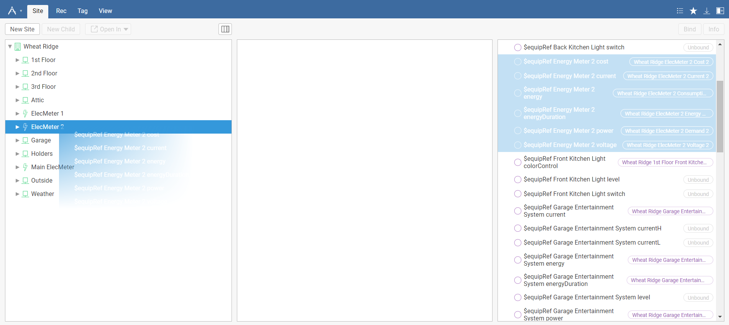
Getting Points with GUI
We recommend using the Builder App’s drag and drop capability to select which points are of interest as there are often many superfluous points

