Slide 2
Disruptive Technologies
This company specializes small, low power sensors
In fact, the company boasts the world’s smallest wireless sensor
It uses a jwt over https/ssl which should yield very strong security
Several different types of connectors are available
The connection is cloud-based

Slide 3
Things that can be Monitored
We have coded most of these into the connector and new ones can be added once their model is known:
Temperature
Humidity
Proximity
Touch/button
Touch counter
Water leak

Slide 4
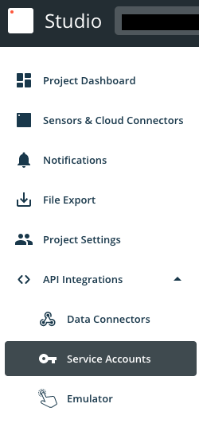
Disruptive Technologies API Set Up I
Log into your Studio account
Go to Service Accounts on the left side of the screen

Slide 5
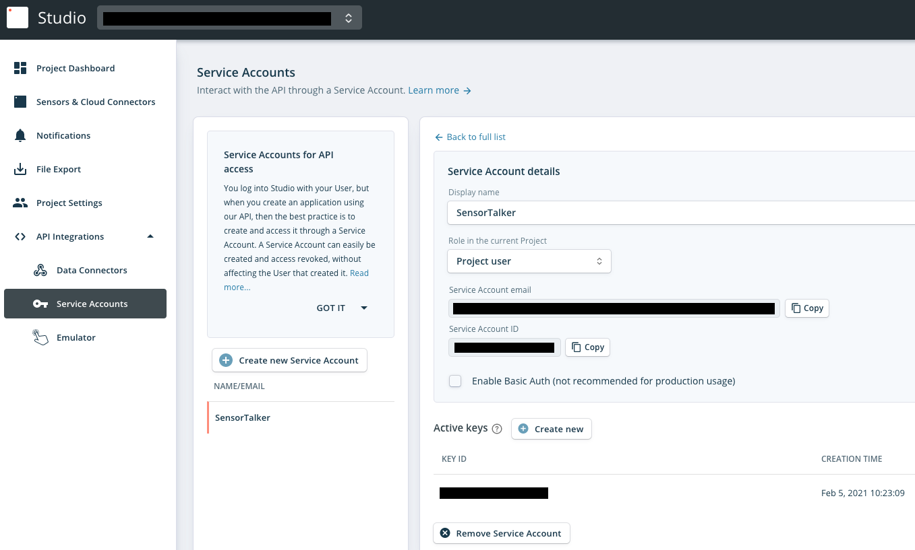
Disruptive Technologies API Set Up II
Create a new Service Account email
Create a new key. Doing this also gives you a secret which will not be available again, so save it somewhere. You will need both of these to gain API access.

Slide 6
Disruptive Technologies Connector Tags in SkySpark
Creating a Disruptive Technologies connector:
dis: Any Readable Name
keyID_secret: Your key and secret go here separated by a . So that’s key.secret
uri: `https://api.disruptive-technologies.com/v2/projects`
serviceAccount: This looks like a complex email address and is just another key you need for API access
The ngbTechPollFreq tag determines the minimum amount of time before the cache can be refreshed and how often the curVal values will be updated (which is from where both polling with intervals and COV come). The default value of 1min is good for detecting COV changes, but feel free to test lower numbers.
Of course, these records will have the ngbTechConn and conn tags
These can be created in the connector app

Slide 7
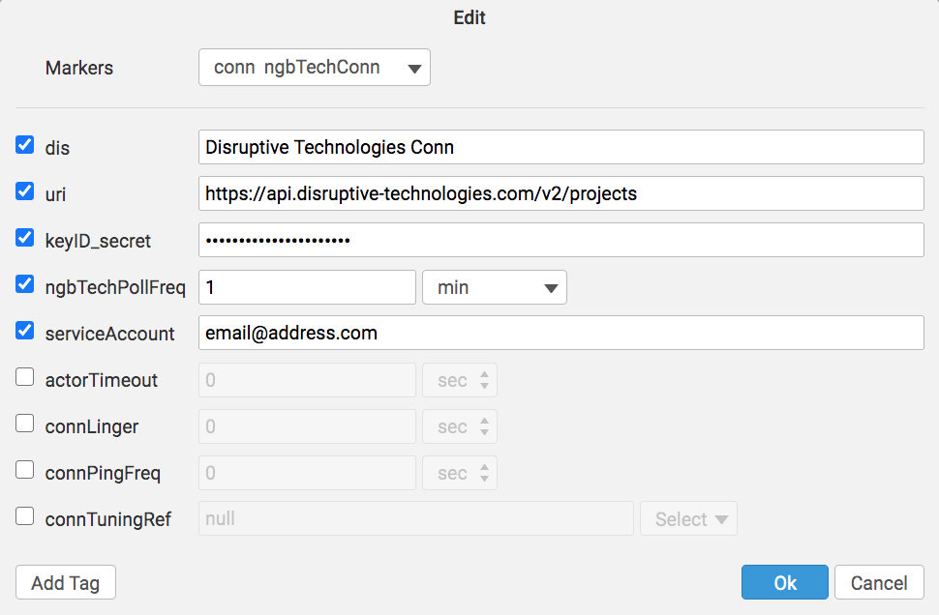
Disruptive Technologies Connector

Slide 8
Disruptive Technologies Functions
ngbTechLearn – return a grid of all pre-coded points (only his points are available)
read(ngbTechConn).ngbTechLearn
ngbTechSyncCur – force one or more cur points to sync
readAll(ngbTechCur).ngbTechSyncCur
ngbTechSyncHis – force one or more his points to sync
readAll(ngbTechHis).ngbTechSyncHis(lastMonth)
ngbTechPing – send ping to connector to check connection
read(ngbTechConn).ngbTechPing
ngbTechCmd – send the connector a custom request
ngbTechToken – used to manually get a new token for requests (shouldn’t ever be needed)

Slide 9
Getting Data for Disruptive Technologies Points Manually or with Automated Jobs
Getting history data from Trend_Logs:
Each point must have these tags:
ngbTechConnRef (ref) which is a ref that points to the Connector
ngbTechHis (str) which points to the Trend_Log object
his (marker)
Run the ngbTechSyncHis(timeRange) function
generally as a task
readAll(ngbTechHis).ngbTechSyncHis(null)
Collecting current values (from curVal):
Each point must have these tags:
ngbTechConnRef (ref) which is a ref that points to the Connector
ngbTechCur (str) which points to the point object
his (marker)
cur (marker)
hisCollectCov (marker or number) for cov collection OR
hisCollectInterval (duration) for polling
Note: we recommend also using a hisCollectInterval of 24hr when using a hisCollectCov to catch faulty sensors.

Slide 10
Basic Troubleshooting
Note that it is normal for a connection to close when it has no points in a watch for a given period of time
For larger systems, you may want to stagger your syncs
Notes on these Trend_Logs
Note that the Trend_Logs in our testing never went further back than a few days
Note that the Trend_Logs in our testing had data every 15 minutes, but they were not lined up with :00, :15, :30, and :45

Slide 11
Getting Points via Code
() => do
varConn: read(ngbTechConn)
varConn.ngbTechLearn().map r => do
r = r.merge(
{
equipRef: read(equip)->id,
siteRef: read(site)->id,
hisCollectInterval: if (r->kind == "Number") 15min,
hisCollectCov: if (r->kind != "Number") marker(),
})
end.each r => commit(diff(null, r, {add}))
Run as a task in large systems to avoid a timeout error

Slide 12
Getting History
For getting history from trend logs:
Your initial import should be a set timeRange. Your reoccurring import will be set up in the Job App and will not need a parameter as it will take the default of null which always gets exactly the right amount of history.
(dates: null) => do
readAll(ngbTechHis).ngbTechSyncHis(dates)
end
Run as task in large systems to avoid a timeout error

