Slide 2
Desigo
  Desigo CC is an integrated building management platform for managing high-performing buildings. With its open design, it has been developed to create comfortable, safe, and efficient facilities. It is easily scalable from simple single-discipline systems to fully integrated buildings.
  It uses a RESTful API with a bearer token to provide security

Slide 3
Why Use this Connector?
Connectors get the same names as you might see in the BAS’ API whereas going BACnet can yield different names and increase the amount of time taken for the import process
Some systems like Andover cannot be accessed via BACnet
Several debugging tools are built into this connector
Several extra features are built into this connector such as the ability to see non-points
There is a fully functional builder tree for navigation

Slide 4
Licensing
  Each Desigo connector extension is licensed to a single SkySpark Node Id
  Each Desigo connector extension is licensed to a set maximum number of points
  If either of these states goes into fault, the issue must be corrected and SkySpark must be restarted

Slide 5

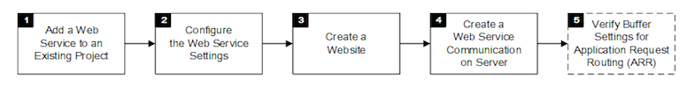
Verify the Following:
Internet Information Services (IIS) is installed
The Web Service extension is installed
The project is created in SMC and started and is an active project
Steps:
1 – Add a Web Service to an Existing Project
  In the SMC tree, select Projects
  Select an existing project
  Click Stop
  Click OK
  Click Add to project
a. In the Select Project Extensions dialog box, click the arrow next to Connectivity and select the Web Services check box
b. Click OK
c. Click Save
  The Web Services Communication expander displays
  The Web Services extension is installed

Slide 6
2 – Configure the Web Service Settings
Click Edit
Click Next
  The Project Settings tab displays. One default Web Service Interface (WSI) instance with default configuration is added.
In the Web Services Communication expander, provide the details as follows:
Enter a new name
  From the drop-down list under Communication, select Secured or Local
  Modify the default ports under Web Services Port, for the Secured (8443) or Local (8080) Communication type
  NOTE: For every WSI instance, enter a unique port number
  Click Browse and select the host certificate, and click OK
  For adding more WSI instances, click Add
  NOTE: Recommended maximum WSI instances to be added is 10
Click on the Web Services Instance row to configure and open the Directories Details expander
Add a Directories folder in the Directories Access tab. For example, add FlexReports directories.
Click Save
To view the web service settings, click the Web Services Settings tab
Click Start Project

Slide 7
3 – Create a Website
  Required: The IIS manager is installed and you have configured the necessary settings
  (Recommended) You have deleted the default IIS website
  Application Request Routing (ARR) is installed on your system. If the IIS settings are not set up correctly, the Application Request Routing may not be visible, so you may need to change the IIS settings and run the Desigo CC installer again.
In the SMC tree, select Websites
Click the Management tab
Click Create Web site
In the Details expander, do the following:
a. In the Name field, enter a new name for the web application
b. In the Path field, browse to select a destination for the website. The default path is [installation drive:]\[installation folder]\[WebSites]\[Web site name]
c. In the User field, browse to select a user for the website
d. In the Select User dialog box, select the user for the web application and enter the password
NOTE: The web application must be a member of the IIS_IUSRS group. If you select a user that is not a member of the IIS_IUSRS group, SMC prompts you to add it.
The user must also have Allow log on locally as Service right set.
e. Enter the password
NOTE: Confirm the website/Web application user and password. If the password has changed, you must modify the website/Web application, and provide the most recent password
f. Change the port numbers if the default cannot be used
g. Click Create to assign a certificate
Click Save
Click OK
NOTE: HTTP is insecure and vulnerable to man-in-the-middle and eavesdropping attacks

Slide 8
4 – Create a Web Service Communication on Server
In the SMC tree, under Websites, select the website
Select the Management tab
Click and select Create Web Services Application
In the Project Information: Web Services Communication expander, from the Project name drop-down list, select a project to which you want to link the web services application
In the Web Application Details expander, do the following:
a. In the Name field, enter a new name for the web services application
b. In the Path field, browse to select a destination for the web services application. The default path is [installation drive:]\[installation folder]\[WebSites]\[Web site name]
c. In the User field, browse to select a user for the web services application using the Select User dialog box
NOTE: The web services application user must be a member of the IIS_IUSRS group. If you select a user that is not a member of the IIS_IUSRS group, SMC prompts you to add it.
The user must also have Allow log on locally as Service right set.
d. Enter the Password
Click Save
Click OK

Slide 9
5 – Verify Buffer Settings for Application Request Routing (ARR)
You want to verify the buffer settings for Application Request Routing (ARR), if WSI is not working
  The IIS Manager is open
  In the Buffer Setting section, set the Response buffer threshold (KB) value to 0
  In the Actions pane, click Apply
Web Service Interface
System Architecture and System Limits
System Limits
The following limits apply when using the Web Service Interface:
  Number of concurrent sessions: 100
  Delay for notifications: <1 second
  5’000’000 value updates / day
  20’000 value subscriptions
  250’000 event notifications / day
  250’000 event-counter notifications / day
  1’000’000 trends / min
NOTE:
The Client versions of Windows (for example, Windows 10) have intentionally feature-limited versions of IIS. One limitation is the number of concurrent connections which can be as low as 10.

Slide 10
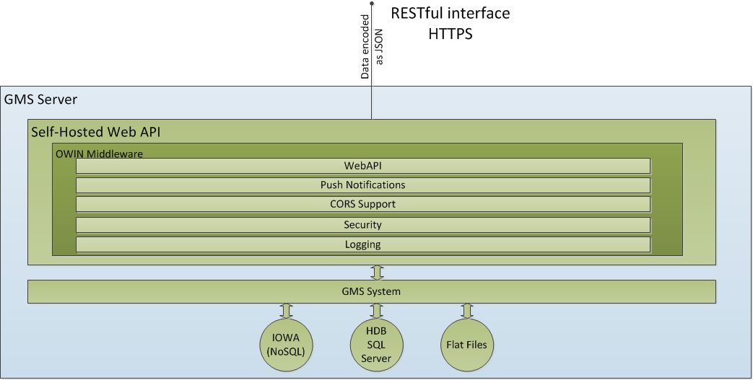
Using the Web Service Interface
Deployment
The Web Service Interface will be deployed as a self-hosted component. It’s an executable and can be commanded as any other IOWA manager.
Communication Web API Server Part
Depending on the deployment, it is likely that in a production environment, the Web Service Interface (and system) will only be accessible through a reverse proxy
Secured Connection Between two Computers
A connection with certificates between IIS and WSI is always required if both applications do not run on the same server. In that case, the IIS-Server must use https to get a certificate confirmation from the connected server. In the SMC, select the option Secured.
Secure Connection on one Computer
A connection without certificates between IIS and Web Service Interface can be established if both applications run on the same server using http. In the SMC, select the option Local.
Web Services Settings during Project Modification
Once the WSI extension is added to the project, during the project modification you can configure the Web Services Settings for multiple WSI instances, including the instance name, the type of communication, web services port, and the host certificate.

Slide 11
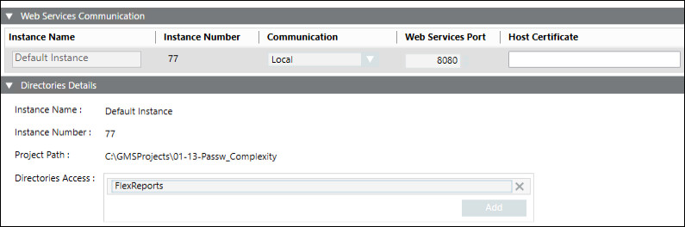
By default, one instance is configured, and you can click Add to add a new WSI instance. The allowed maximum WSI instances to be added is 10.
  Instance Name: Change the default to modify the WSI instance name
  Communication: Configure any of the following:
  Secured: (Recommended when working with remote IIS Server hosted on Client/FEP system). When selected, allows you to enable secure communication by configuring the web services port and host certificate.
  Local: When selected allows you to set up local communication between Server and WSI
  Web Services Port: Change the port number
  Host certificate: Enabled only when you set the communication type as secured
  Add: Adds a WSI instance
  Remove: Removes a WSI instance
  Directory Access: Creates a folder access to save the directories file in GMSProjects folder

Slide 12
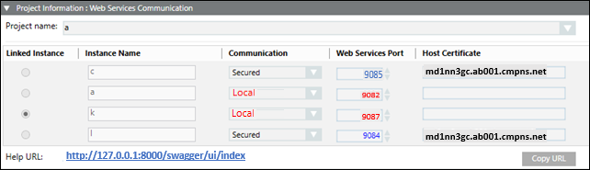
Web Services Application Creation and Modification
In the SMC tree, when you select Websites > [Website name], click
and select Create Web Services Application, you can create and configure web services application using the following expanders:
Server Information Expander
This expander by default displays the Server name where you are creating the web services application. You cannot change it.
Project Information: Web Services Communication Expander
This expander allows you to select and link a WSI instance of a Server project to the web services application.
Web Application Details Expander
This expander allows you to configure the web services application details including the Name, Path, User, and Password

Slide 13
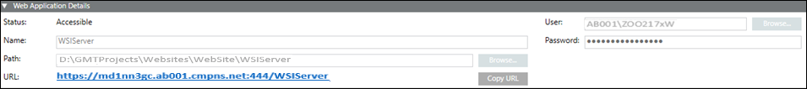
Name: Type the name
Following special characters are not permitted in the web services application name:
‘\\', '/', '?', ';', ':', '@', '&', '=', '+', '$', ',', '|', ' " ', '<', '>'.
Path: Browse for the location on the disk where you want to store the web services application. The default is [installation drive:]\[installation folder]\[Websites folder]\[Website name].
Following special characters are not permitted in the web services application path:
'ä', 'ö', 'ü', '$', '@', '&', '<', '>', '{', '}', '[', ']', '(', ')', ';', ':', '=', '^', '|', '*', '!',
'/', '%', '?', ',', '\'', '"', '\t', ‘\\', '+' .
  For path specifications, consider case sensitivity and do not use blanks.
  Names must start with a letter and only allow letters, numbers and underscore ("_")
  User: Browse and select a web services application user using the Select User dialog box
NOTE 1: The web services application user should be a member of IIS_IUSRS group. If you select a user who is not a member of the IIS_IUSRS group, the SMC prompts you to add the user to that group.
NOTE 2: You can create a web services application with a user different from the website user.
NOTE 3: The user must also have Allow log on locally as Service right set.
  Password: Type the password
NOTE:
Once the web services application is created, if you click Edit ,
you can modify the linked project. In case of an upgrade, of web application, if linked project is not upgraded then a message stating "Project needs to be upgraded before upgrading [web application]" displays.

Slide 14
Desigo Connectors in SkySpark
Creating a Desigo connector:
  dis: Any Readable Name
  uri: `http://host/xyz/api/` ie `https://desigo.net/proc/api/`
  desigoUsername: This will be provided by your Desigo Team
  desigoPassword: This will be provided by your Desigo Team
  serverNo: Some buildings have multiple Desigo servers running. If you are not sure, start with: 1
  The desigoPollFreq tag determines the minimum amount of time before the cache can be refreshed and how often the curVal values will be updated (which is from where both polling with intervals and COV come). The default value of 1min is good for detecting COV changes. The curVals do not matter for trend log synching.
  Of course, these records will have the desigoConn and conn tags
These can be created in the connector app

Slide 15
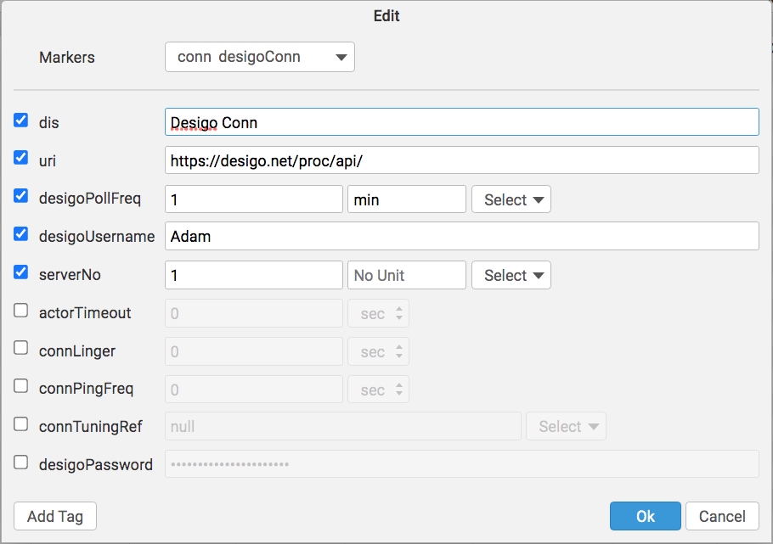
Desigo Connector

Slide 16
Desigo Connector Set Up
  The connector should authenticate by itself and stay authenticated automatically, but if you need to give it jumpstart or wake it up, you may run: read(desigoConn).desigoToken
  If the connector has the logout7 tag, it will log out of a user session after cur and his syncs are completed

Slide 17

Polling of curVal
desigoPollFreq (duration)
  How often you want SkySpark to poll the connector for COV
  The default is 1min
  It is a tuning parameter
  Note that this determines how often the curVal in SkySpark changes. You would still need to set how often the data is collected with the hisCollect tags.

Slide 18
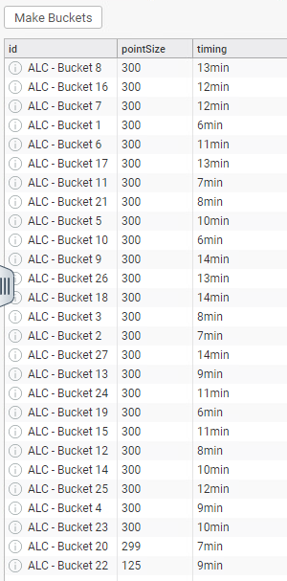
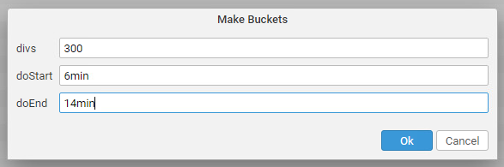
Setting Up Tuning Buckets (not needed for Desigo)
Tuning buckets allow you to easily set up curVal points to sync in batches. The timing field in this view is actually the pollFreq and is how often new values are checked for for a given point.
Go to the Desigo App
Go to the Tuning Buckets Tab
Click Make Buckets if no points are shown and you want to use the buckets framework. In this case, you will also want to push this button after adding points to the connector so the new points use the buckets framework.
divs are the number of points in a bucket
doStart is the number of minutes the buckets will start at
doEnd is the number of minutes the buckets will go to until they loops back around to the doStart value

Slide 19
Desigo Functions Part 1
desigoCmd – send Desigo a custom get request
  read(desigoConn).desigoCmd("systemBrowser/1/9?searchstring=*&objecttypeFilter={\"7400\":[]}")
desigoPost – send Desigo a custom post request
  read(desigoConn).desigoPost
desigoLearn – return a grid of all available cur and his points (walkable in Builder)
  read(desigoConn).desigoLearn
desigoRawLearn – return a grid of all available cur and his points
  read(desigoConn).desigoRawLearn
desigoSyncHis – sync history from a trend log
  readAll(desigoHis).desigoSyncHis(null)
desigoSyncCur – force one or more points to sync
  readAll(desigoCur).desigoSyncCur
desigoPing – send ping to connector to check connection
  read(desigoConn).desigoPing

Slide 20
Desigo Functions Part 2
desigoLearnFiltered – get objectType 7400 points with a given string filter
  read(desigoConn).desigoLearnFiltered("temp")
desigoHisRead – attempt to do a raw read from Desigo without synching
  Use the debug marker tag on the connector to get the raw history coming from Desigo
  read(desigoConn).desigoHisRead(read(desigoHis))
  read(desigoConn).desigoHisRead("Building1.Zone1.Temp", today)
desigoVals – return a list of addresses and curVals
  read(desigoConn).desigoVals(readAll(desigoCur))
  read(desigoConn).desigoVals(null, ["pointAddr1", "pointAddr2"])
desigoPoints – get all objectType 7400 points
  read(desigoConn).desigoPoints()
desigoTrends – do a read from the trends table
  readAll(desigoHis).desigoTrends()

Slide 21
Desigo Functions Part 3
desigoEverything – get all objectTypes from the systemBrowser
  readAll(desigoCur).desigoEverything()
desigoGetServer – get the name of the Desigo server
  read(desigoConn).desigoGetServer()
desigoToken – get a bearer token to use for requests
  Use the debug marker tag on the connector to get the raw response if you are not getting a token
  read(desigoConn).desigoToken()
desigoLogout – log out of a user session on the Desigo server
  read(desigoConn).desigoLogout()

Slide 22
Desigo Functions Part 4
desigoLearnCodes – return typeIDs to be used with the desigoLearnPointsMultiCodes() functtion
  read (desigoConn).desigoLearnCodes()
desigoLearnPointsMultiCodes – return points with the specified typeIDs; below is the default
  read(desigoConn).desigoLearnPointsMultiCodes([1100,2200,6700,7800])
desigoLearnSubPoints – return Desigo SubPoints for a given Desigo address
  read(desigoConn).desigoLearnSubPoints("System1:GMS_AP1_B01.AH01.TECSW100")

Slide 23
Desigo View Functions
desigoDupFinder – find points with the same addresses (default true will add dupPoint tag to point)
  desigoDupFinder(true)
desigoMakePointsToBuckets – assigns tuning records to Desigo curVal points (use desigoTuningBuckets view)
  Number of points per connTuningRec
  desigoMakePointsToBuckets(100)
desigoMakeTuningBuckets – makes Desigo Tuning records (use desigoTuningBuckets view)
  Number of points per connTuningRec, starting pollFreq, max pollFreq
  desigoMakeTuningBuckets(100, 5min, 9min)
desigoViewStatus – see Desigo points
  desigoViewStatus()
desigoViewSummary – see status of Desigo points
  desigoViewSummary()
desigoViewTuning – display Desigo tuning records
  desigoViewTuning()

Slide 24
Getting Data for Desigo Points
Manually or Automatically
  Collecting current values (from curVal):
    Each point must have these tags:
      desigoConnRef (ref) which is a ref that points to the Desigo Connector
      desigoCur (str) which points to the Desigo point object
      his (marker)
      cur (marker)
      hisCollectCov (marker or number) for cov collection OR
      hisCollectInterval (duration) for polling
  Getting history data from Trend Logs:
    Each point must have these tags:
      desigoConnRef (ref) which is a ref that points to the Desigo Connector
      desigoHis (str) which points to the Desigo Trend Log object
      his (marker)
      Run the desigoSyncHis(timeRange) function
        generally as a task
        readAll(desigoHis).desigoSyncHis(null)
      Note: we recommend also using a hisCollectInterval of 24hr when using a hisCollectCov to catch faulty sensors.

Slide 25
Special Feature
This connector will automatically convert data (that is “convertible”) based on the point’s kind tag in SkySpark.
Kind = Str: the connector will keep the incoming data as a Str. This can even be used to historize errors.
Kind = Bool: If the incoming data are 0s and 1s, they will automatically be converted to false and true
Kind = Number: If needed, Str values will be parsed to Number

Slide 26
convertTo Feature
In rare cases, you may want to convert the data to something other than a point’s datatype. This allows you to set up enums or other conversions.
You can do this today for desigoHis and desigoCur points.
The connector will do this before anything else.
The tag options are:
  convertTo: "Str"
  convertTo: "Number"
  convertTo: "Bool”
The flow is:
  Use convertTo to set up what you want the value to come in as
  Use hisConvert, curConvert, or hisOnWrite to convert from convertTo to kind.
  Use kind to state the final value you want SkySpark to store.

Slide 27
Basic Troubleshooting
If you see: Unexpected token 60, it usually means your connector’s uri is wrong. Note that it needs to end in /api/.
Note that it is normal for a connection to close when it has no points in a watch for a given period of time
For larger systems, you want to set the poll frequency to a higher value to avoid network congestion
Make sure time zones, kinds, and units are the same in SkySpark and Desigo
Desigo curVal synching does not seem sensitive to tuning buckets. In fact, we have not seen a limit for a single bucket, so buckets aren’t really needed.
If too many Desigo user sessions are noticed on the Desigo side, you can decrease the user session timeout setting. Unfortunately, when a token expires, the new token comes in as a new user session.

Slide 28
Desigo TypeIDs
More useful:
7400 = trend logs - typeDescriptor = Trend
1100 = TEC Point also point on PXC - typeDescriptor = Command
2200 = Digital Point - typeDescriptor = Detector
6700 = Analog Sensor - typeDescriptor = Sensor
7800 = Calculated Point - typeDescriptor = Value
2300 = Device - typeDescriptor = Device
Less Useful:
6300 = Schedule - typeDescriptor = Scheduler
6000 = Program - typeDescriptor = Program
3700 = Group - typeDescriptor = Group
3600 = Graphics - typeDescriptor = Graphics
4600 = Group Graphics? - typeDescriptor = Library Element
2100 = Potentially BACnetPoint
7700 = User - typeDescriptor = User
8000 = Views - typeDescriptor = View Element
6400 = User allowed Scope? - typeDescriptor = Scope
2600 = Document - typeDescriptor = Document

Slide 29
Getting Points via Code
() => do
dConn: read(desigoConn)
dConn.desigoRawLearn().map r => do
r = r.merge(
{
equipRef: read(equip)->id,
siteRef: read(site)->id,
hisCollectInterval: if (r->kind == "Number") 15min,
hisCollectCov: if (r->kind != "Number") marker(),
})
end.each r => commit(diff(null, r, {add}))
end
Run as a task in large systems to avoid a timeout error

Slide 30
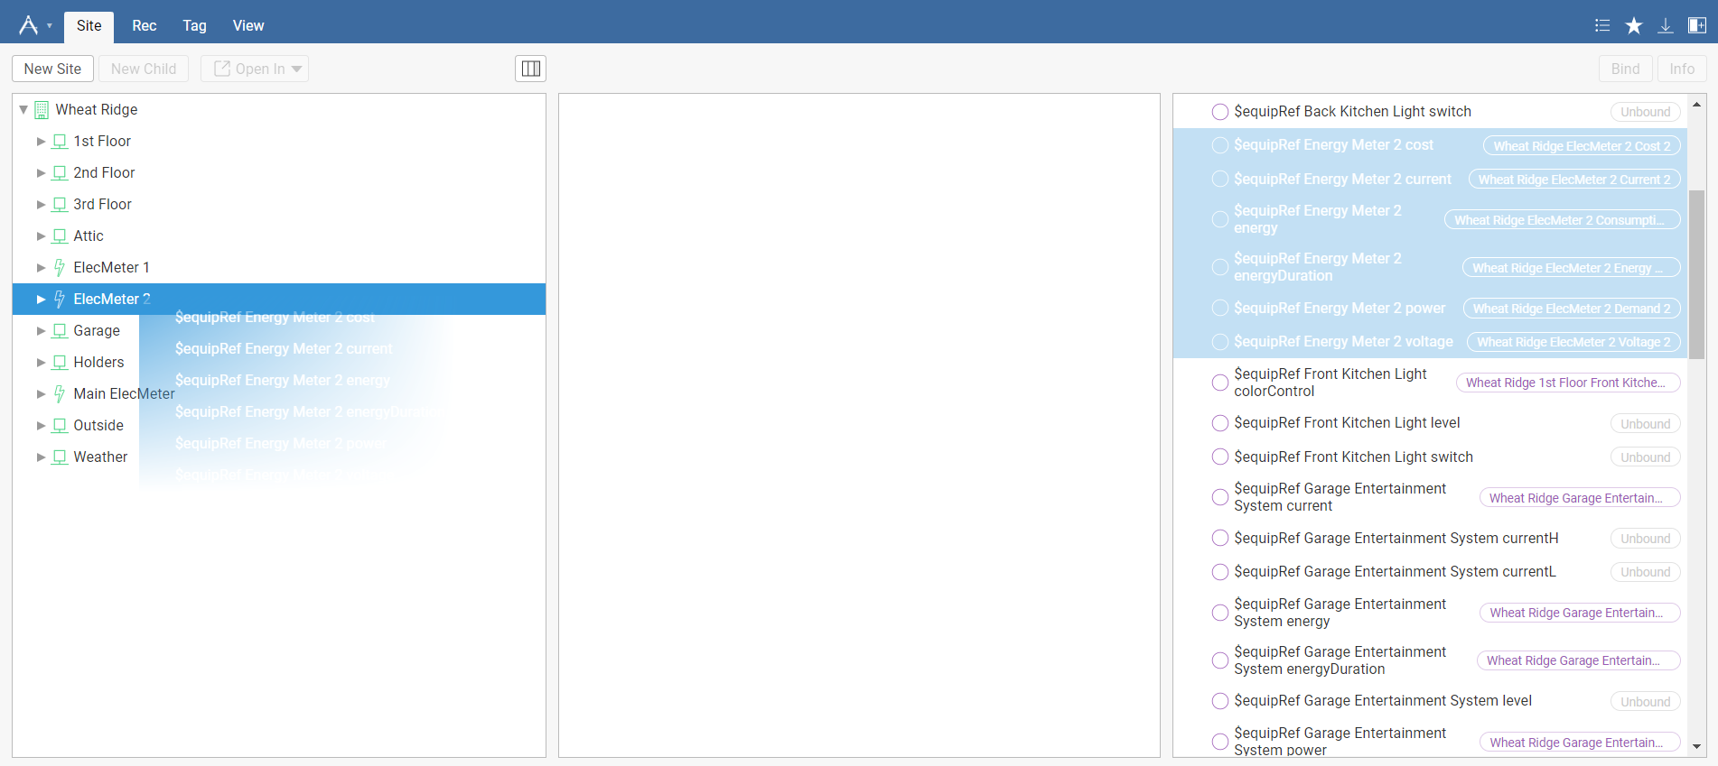
Getting Points with GUI
We recommend using the Builder App’s drag and drop capability to select which points are of interest as there are often many superfluous points

