Slide 1


Slide 2
ALC
  Automated Logic's WebCTRL® is a building automation system that offers an intuitive user interface and powerful control features. Your building can be accessed from anywhere in the world using your favorite browser, eliminating the need for special software on the workstation or tablet.
  It uses a SOAP-like API with a username and password. SOAP is essentially XML in and XML out.

Slide 3
Why Use this Connector?
Connectors get the same names as you might see in the BAS’ API whereas going BACnet can yield different names and increase the amount of time taken for the import process
Some systems like Andover cannot be accessed via BACnet
Several debugging tools are built into this connector
Several extra features such as comprehensive reports are built into this connector. Some of these reports may not be available in WebCTRL itself.
There is a fully functional builder tree for navigation

Slide 4
Licensing
  Each ALC connector extension is licensed to a single SkySpark Node Id
  Each ALC connector extension is licensed to a set maximum number of points
  If either of these states goes into fault, the issue must be corrected and SkySpark must be restarted

Slide 5
Setting Up the WebCTRL Service
  Admin access in WebCTRL is needed to create a new Operator with the SOAP Privilege Set (System)
  See screenshot on the next slide for user privileges needed to utilize the SOAP API in WebCTRL. Click Accept when finished (not shown in screenshot).
  HTTPS is enabled by default HTTP is not.
    To enable SOAP over HTTP: change the default setting in SiteBuilder || Configure || Preferences || allow SOAP over HTTP

Slide 6
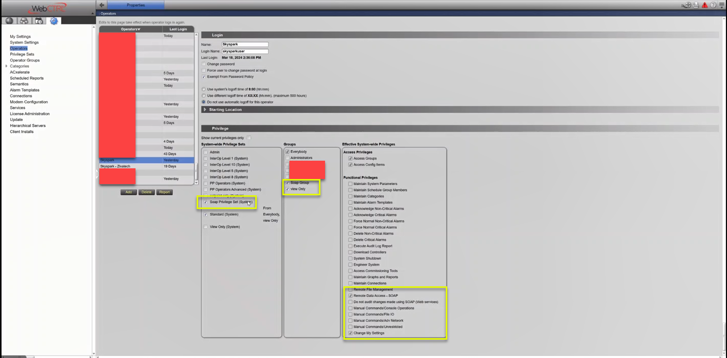
Setting Up the WebCTRL Service (contd.)

Slide 7
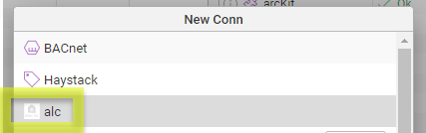
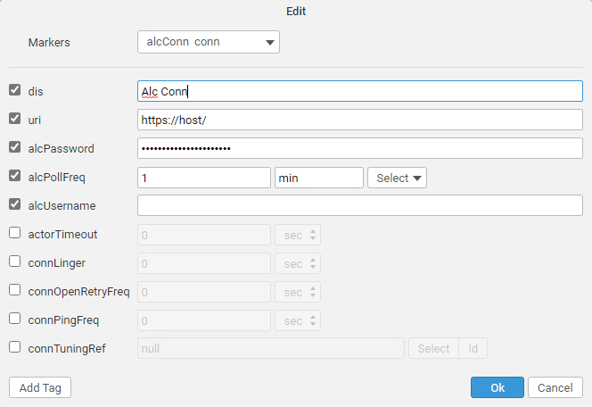
ALC Connectors in SkySpark
In the connector app, select new and pick alc, then fill in the following fields:
dis: Display name
uri: `https://host` ie `https://alc.net/`
alcUsername: Provided by WebCTRL admin
alcPassword: Provided by WebCTRL admin
actorTimeout: How long a busy connector will wait to respond to a new message
alcPollFreq: Minimum amount of time between cache refreshes. This determines how often the curVal values will be updated. The default value of 1min is a good starting point.
All ALC connector records will have the alcConn and conn tags

Slide 8
ALC Connector

Slide 9
ALC Connector Set Up
  You must set up the API on the ALC side, then SkySpark will be able to talk to it. As long as the uri, username, and password are correct, it should work.

Slide 10
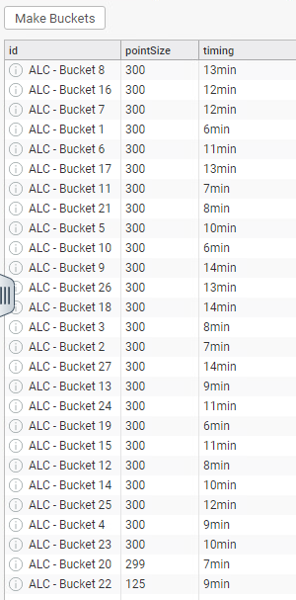
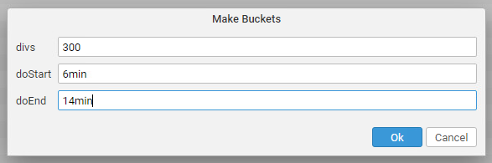
Setting Up Tuning Buckets
Tuning buckets allow you to easily set up curVal points to sync in batches. The timing field in this view is actually the pollFreq and is how often new values are checked for for a given point.
Go to the ALC App
Go to the Tuning Buckets Tab
Click Make Buckets if no points are shown and you want to use the buckets framework (needed for ALC after ~400 points). In this case, you will also want to push this button after adding points to the connector so the new points use the buckets framework.
divs are the number of points in a bucket
doStart is the number of minutes the buckets will start at
doEnd is the number of minutes the buckets will go to until they loops back around to the doStart value

Slide 11

Polling of curVal
alcPollFreq (duration)
  How often you want SkySpark to poll the connector for COV
  The default is 1min
  It is a tuning parameter
  Note that this determines how often the curVal in SkySpark changes. You would still need to set how often the data is collected with the hisCollect tags.

Slide 12
ALC Functions Part I
alcSyncHis – sync history from a trend log.
  readAll(alcHis).alcSyncHis(null)
alcSyncCur – force one or more points to sync
  readAll(alcCur).alcSyncCur
alcPing – send ping to connector to check connection
  read(alcConn).alcPing
alcHisRead – attempt to do a raw read from ALC without synching (will tell you if point is trended)
  read(alcConn).alcHisRead(read(alcHis)) read(alcConn).alcHisRead("trees/geographic/pointAddr", today)
alcVals – return a list of addresses and curVals (good for testing if an address exists)
  Use the debug marker tag on the connector to return the raw XML
  read(alcConn).alcVals(readAll(alcCur)) read(alcConn).alcVals(null, ["pointAddr1", "pointAddr2"])
alcLearnTool – this gets display names, but not actual point addresses – it’s an ALC point list report
  read(alcConn).alcLearnTool("trees/geographic")

Slide 13
ALC Functions Part 2
alcWsdl – A WSDL is the instructions for a SOAP command. Defaults to Report. Can also use Eval, Trend, or System.
  read(alcConn).alcWsdl("Eval")
alcReport – Run any of the following reports. It takes a report and a location.
  Use the debug marker tag on the connector to return the result in html
  ~schedule-instance ~effective-schedule ~point-list-report ~locked-value ~network-io ~test-and-balance ~equipment-checkout ~audit-log ~alarms ~alarm-source ~network-status ~module-version ~security-assignment ~alarm-messages ~alarm-actions ~trend-usage ~parameter-mismatch
  readAll(alcConn).alcReport("~point-list-report", "trees/geographic")
alcChildren – used for the builder learn, but get the children nodes for any node
  Use the debug marker tag on the connector to return the raw XML
  readAll(alcConn).alcChildren("trees/geographic")

Slide 14
ALC View Functions
alcDupFinder – find points with the same addresses (default true will add dupPoint tag to point)
  alcDupFinder(true)
alcMakePointsToBuckets – assigns tuning records to ALC curVal points (use alcTuningBuckets view)
  Number of points per connTuningRec
  alcMakePointsToBuckets(100)
alcMakeTuningBuckets – makes ALC Tuning records (use alcTuningBuckets view)
  Number of points per connTuningRec, starting pollFreq, max pollFreq
  alcMakeTuningBuckets(100, 5min, 9min)
alcViewStatus – see ALC points
  alcViewStatus()
alcViewSummary – see status of ALC points
  alcViewSummary()
alcViewTuning – display ALC tuning records
  alcViewTuning()

Slide 15
Getting Data for ALC Points
Manually or Automatically
  Collecting current values (from curVal):
    Each point must have these tags:
      alcConnRef (ref) which is a ref that points to the ALC Connector
      alcCur (str) which points to the ALC point object
      his (marker)
      cur (marker)
      hisCollectCov (marker or number) for cov collection OR
      hisCollectInterval (duration) for polling
  Getting history data from Trend Logs:
    Each point must have these tags:
      alcConnRef (ref) which is a ref that points to the ALC Connector
      alcHis (str) which points to the ALC Trend Log object
      his (marker)
      Run the alcSyncHis(timeRange) function
        generally as a task
        readAll(alcHis).alcSyncHis(null)
      Note: we recommend also using a hisCollectInterval of 24hr when using a hisCollectCov to catch faulty sensors.

Slide 16
Special Feature
This connector will automatically convert data (that is “convertible”) based on the point’s kind tag in SkySpark.
Kind = Str: the connector will keep the incoming data as a Str. This can even be used to historize errors.
Kind = Bool: If the incoming data are 0s and 1s, they will automatically be converted to false and true
Kind = Number: If needed, Str values will be parsed to Number
  Many points that show as numbers in WebCTRL are passed as Str and might have needed his or curConverts with other older ALC connectors. Those converts are no longer needed.
This feature is not used when writing back to ALC

Slide 17
convertTo Feature
In rare cases, you may want to convert the data to something other than a point’s datatype. This allows you to set up enums or other conversions.
You can do this today for alcHis and alcCur points.
The connector will do this before anything else.
The tag options are:
  convertTo: "Str"
  convertTo: "Number"
  convertTo: "Bool”
The flow is:
  Use convertTo to set up what you want the value to come in as.
  Use hisConvert, curConvert, or hisOnWrite to convert from convertTo to kind.
  Use kind to state the final value you want SkySpark to store.

Slide 18
Writing to ALC Points from SkySpark
Manually or with Automated Tasks
Writing/Sending current values to a ALC point:
  Each point must have these tags:
    alcConnRef (ref) which is a ref that points to the ALC Connector
    alcWrite (string) which points to the ALC point object
    writable (marker)
  Note: The pointWrite() command is the only writing command that is truly supported. The pointAuto() function is only used to clear the writeVal on SkySpark’s end. It does not do anything on the device’s end.

Slide 19

Basic Troubleshooting
Note that it is normal for a connection to close when it has no points in a watch for a given period of time
For larger systems, you want to set the poll frequency to a higher value to avoid network congestion
Make sure time zones, kinds, and units are the same in SkySpark and ALC
ALC seems very sensitive towards buckets. The absolute limit in testing appeared to be around 450 points / bucket.
This error:
appears to be caused by: HTTP Status 401 – Unauthorized
in other words: credentials

Slide 20
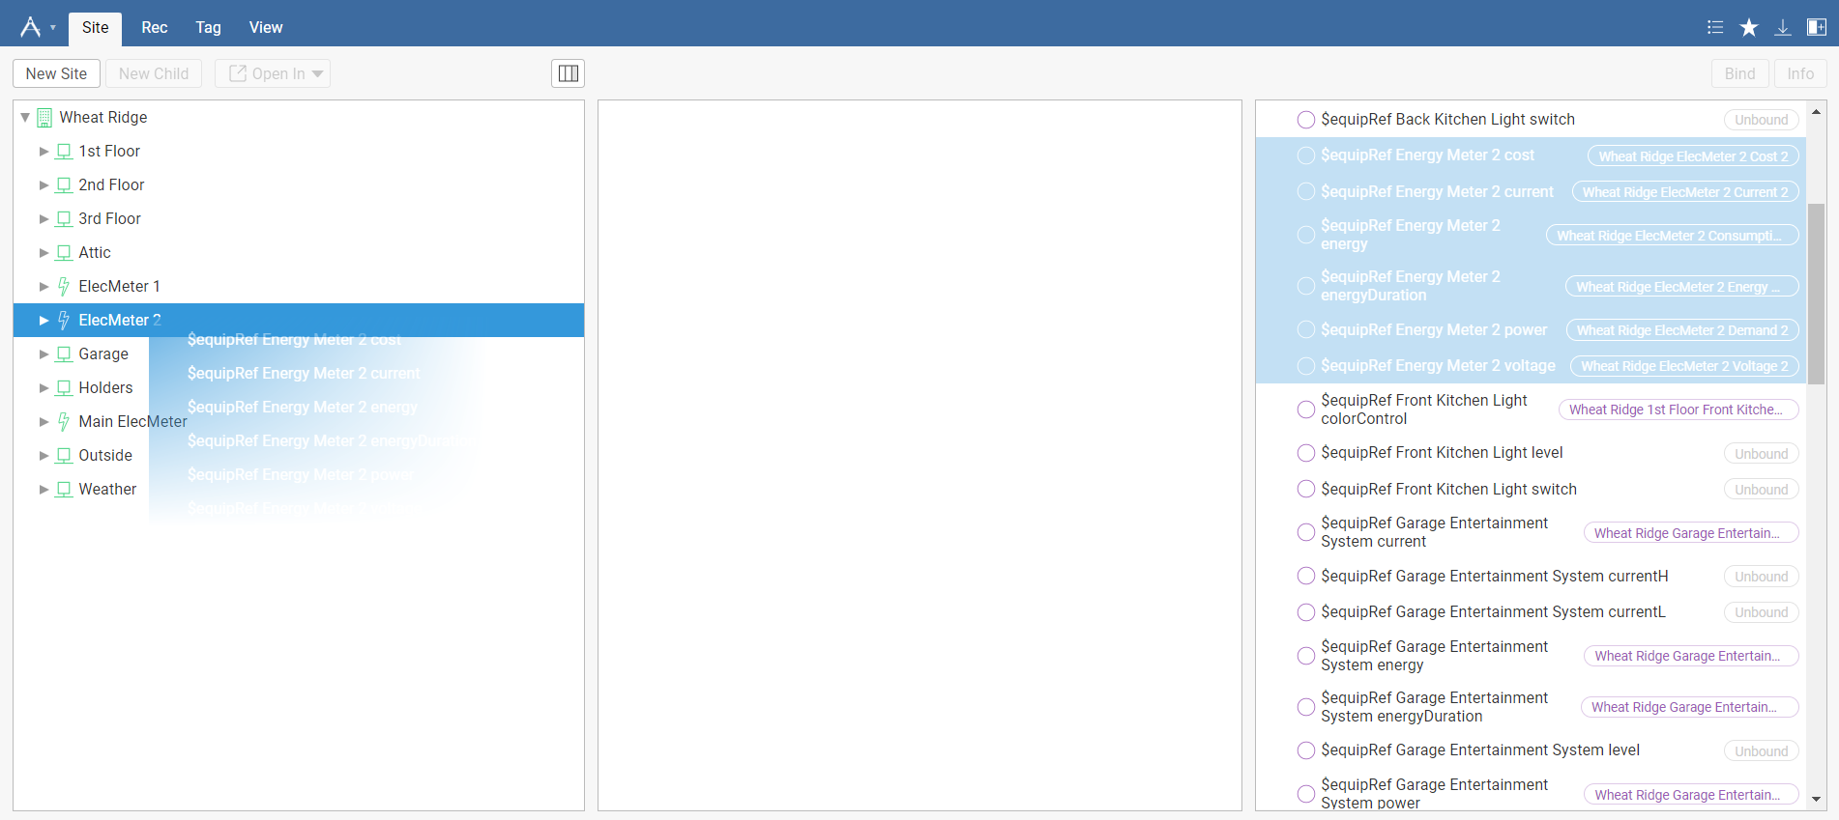
Getting Points with GUI
We recommend using the Builder App’s drag and drop capability to select which points are of interest as there are often many superfluous points

